Slide 1
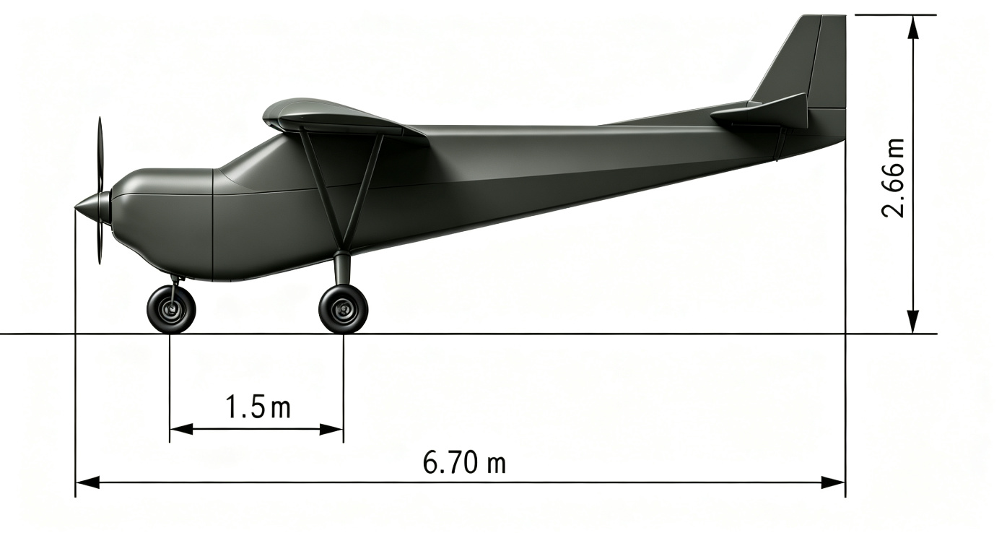
PRODUCT MANUAL · V1.0 · 产品说明书
AI-101 空中吉普 / Sky Jeep
大型固定翼物流无人机 · 产品说明书
Large Fixed-Wing Cargo UAV · Product Manual
McLean (Shanghai) Intelligent Technology Co., Ltd. · 麦克兰（上海）智能科技有限公司 · Aug 2026
Notes:
Welcome to the AI-101 Sky Jeep Product Manual. This manual provides detailed specifications, flight performance, system architecture, operating procedures and maintenance requirements for the AI-101 large fixed-wing cargo UAV. Please read carefully before operation. 欢迎使用AI-101空中吉普产品说明书。本说明书详细介绍AI-101大型固定翼物流无人机的技术规格、飞行性能、系统组成、操作指南和维护保养要求。请在使用前仔细阅读。

Slide 2
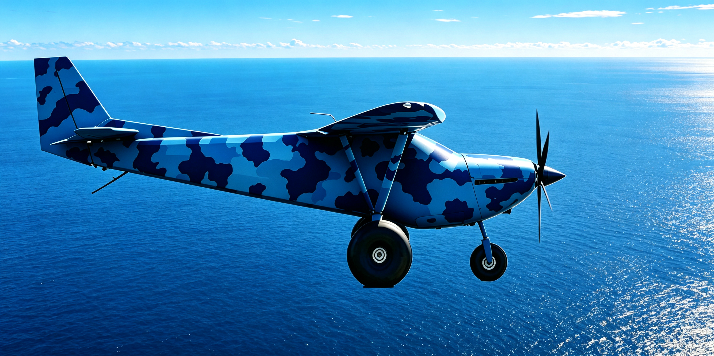
CONTENTS · 目录
12 Chapters · 共12章节
01
产品简介 / Product Overview
Table of Contents
02
外观与尺寸 / Dimensions
03
技术规格 / Technical Specifications
04
飞行性能 / Flight Performance
05
系统组成 / System Architecture
06
地面控制站 / Ground Control Station
07
操作指南 / Operating Procedures
08
应用场景 / Application Scenarios
09
安全须知 / Safety Instructions
10
维护保养 / Maintenance
Doc No.: EN-DRP-A101-MAN-V1.0
Ref: EN-DRP-A101-141 V1.2
Classification: Public / 公开
All specifications subject to change without notice. / 本说明书内容如有更新，恕不另行通知。
Please refer to the latest version. / 请以最新版本为准。
Notes:
This manual contains 10 main chapters covering product overview, dimensions, technical specifications, flight performance, system architecture, ground control station, operating procedures, application scenarios, safety instructions and maintenance. 本产品说明书共分为10个主要章节，涵盖产品简介、外观与尺寸、技术规格、飞行性能、系统组成、地面控制站、操作指南、应用场景、安全须知和维护保养。

Slide 3
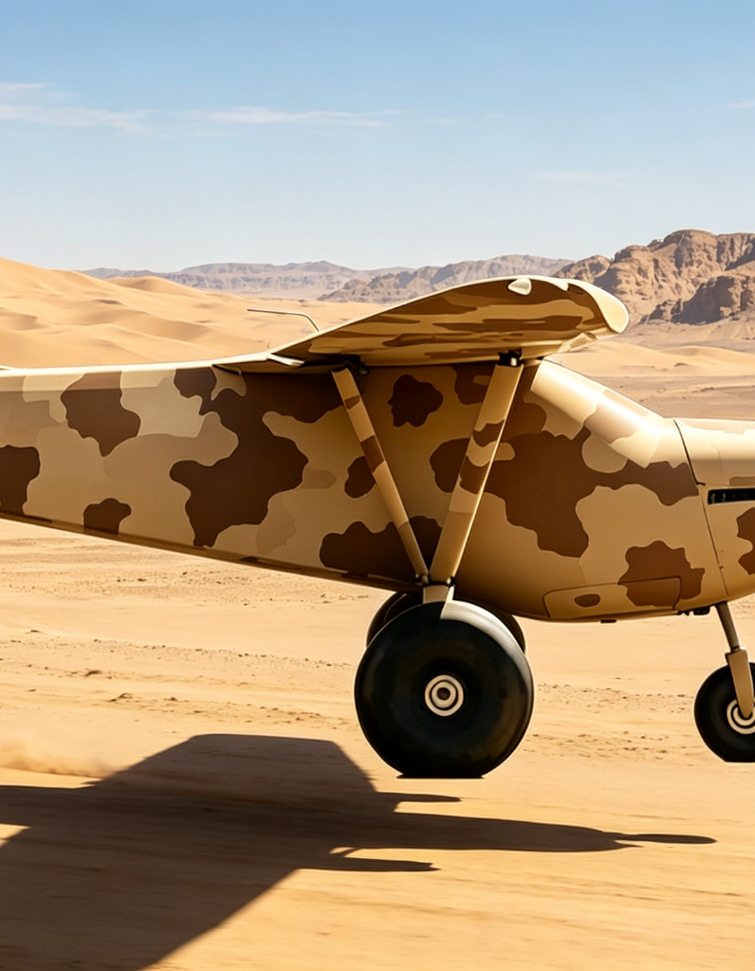
01
产品简介 / Product Overview
AI-101 “Sky Jeep” is a 1,000kg-class large fixed-wing cargo UAV developed by McLane (Shanghai) Intelligent Technology. It features high-wing conventional layout, OP-200T aero piston engine, STOL capability, large payload and long range.
AI-101“空中吉普”是麦克兰（上海）智能科技自主研发的1,000kg级大型固定翼物流无人机，上单翼常规布局，“东方明珠”OP-200T航空活塞发动机，超短距起降、大商载、长航程。
1000kg
500kg
MTOW 最大起飞重量
Max Payload 最大商载
800km
≤100m
Max Range 最大航程
STOL Distance 起降距离
核心特性 / Key Features
• STOL: Full-span flaperon, dirt/grass runway capable / 超短距起降：全展长襟副翼，土路草地即可起降
• High Reliability: Triple FMC,Triple IMU, dual redundant servo, 4-layer defense / 高可靠性：三冗余飞控、三冗余IMU、双余度舵机、四级纵深防御
• Modular Cargo: ≥0.8m³, quick-swap payloads / 模块化货舱：≥0.8m³，支持快速换装多任务载荷
• Airworthiness: CCAR-92 compliant, DAS certified / 适航认证：按CCAR-92运行，设计保证系统符合局方要求
Notes:
AI-101 Sky Jeep is a 600kg-class large fixed-wing cargo UAV with 170kg max payload, 700km max range, and ≤100m STOL capability. AI-101空中吉普是一款600公斤级大型固定翼物流无人机，最大商载170公斤，最大航程700公里，起降距离不超过100米。

Slide 4
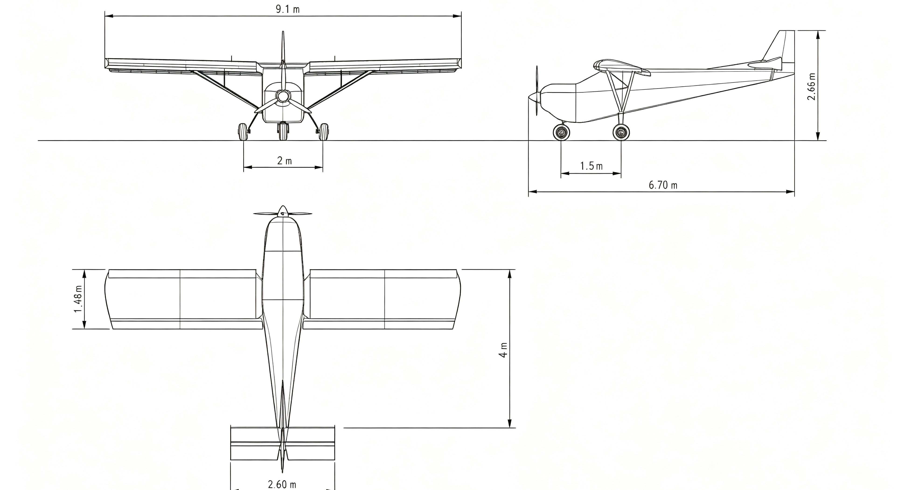
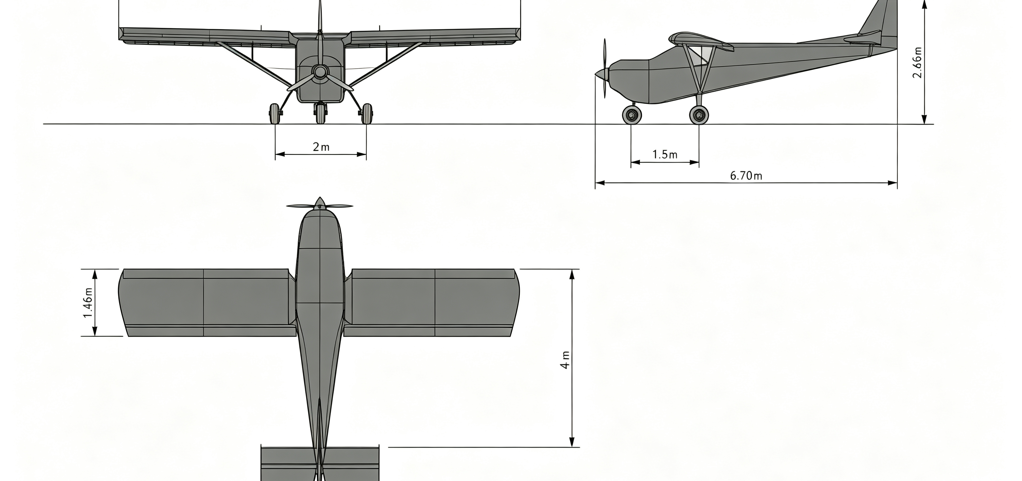
02
外观与尺寸 / Dimensions
Military Gray Livery / 军用深灰色涂装渲染
9.1m
6.7m
Wingspan 翼展
Length 机长
Three-view Drawing / 三视图（Front / Side / Top）
2.7m
1.8m
Height 机高
Propeller Dia. 螺旋桨直径
High-wing conventional layout, high aspect ratio wing for optimal lift-to-drag ratio. Full-span flaperons enable STOL. Tricycle landing gear adapts to rough runways. / 上单翼常规布局，大展弦比机翼，全展长襟副翼实现超短距起降，前三点起落架适应简易跑道。
Notes:
AI-101 features high-wing conventional layout with 14.8m wingspan, 8.5m length, 2.8m height and 2.0m propeller diameter. AI-101采用上单翼常规布局，翼展14.8米，机长8.5米，机高2.8米，螺旋桨直径2.0米。

Slide 5
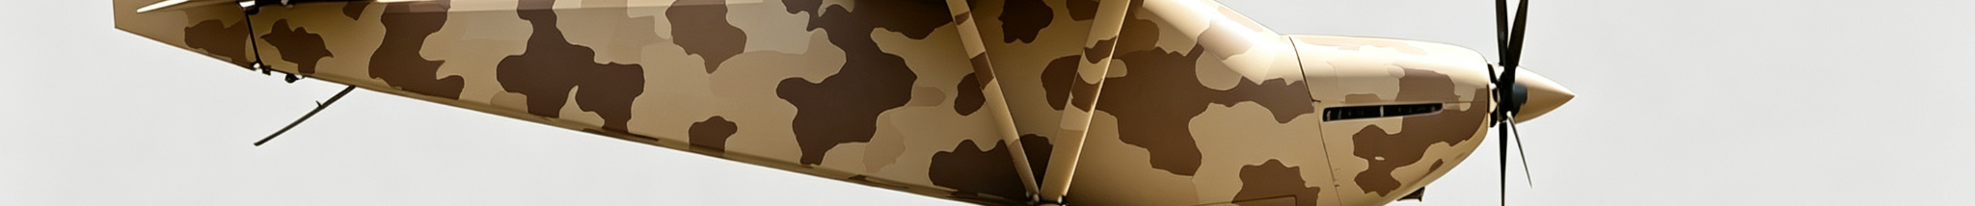
03
技术规格 / Technical Specifications
重量与载荷 / Weight & Payload
动力与燃油 / Power & Fuel
系统配置 / System Config
Engine 发动机型号 | OP-200T
Type 类型 | Turbo Piston 涡轮增压
Max Power 最大功率 | 200 HP
Propeller 螺旋桨 | XF31C-69
Fuel Type 燃油 | 95# Gasoline 95号汽油
Cruise Fuel Burn 巡航油耗 | ~28 L/h
FCC 飞控计算机 | Triple Redundancy 三冗余FCC
IMU | Triple 三冗余
Servo Redundancy 舵机 | Dual 双余度
C2 Link 测控链路 | Heterogeneous Dual 异构双链路
Navigation 导航 | GNSS+INS
Power System 电源 | Dual Channel 双通道
MTOW 最大起飞重量 | 1000 kg
Max Payload 最大商载 | 500 kg
Fuel Capacity 燃油量 | 110 L
Cargo Volume 货舱容积 | ≥1.0 m³
设计标准与认证 / Design Standards & Certification
• Operations: CCAR-92 (Civil UAV Operational Safety Regulations) / 运行规范：CCAR-92部《民用无人驾驶航空器运行安全管理规则》
• Design Assurance: Compliant with authority DAS requirements, full requirements traceability & verification / 设计保证：符合局方设计保证系统要求，完整需求追溯与验证体系
• Airworthiness Basis: ASTM F2339 (Light Sport Aircraft), critical systems meet DO-178C/DO-254 / 适航基础：参考ASTM F2339轻型运动航空器标准，关键系统满足DO-178C/DO-254
• Data Source: All parameters per EN-DRP-A101-141 V1.2 Design Characteristics Report / 数据来源：所有参数依据EN-DRP-A101-141 V1.2《设计特征报告》
Notes:
Technical specifications cover weight & payload, power & fuel, and system configuration. 技术规格涵盖重量与载荷、动力与燃油、系统配置三大类。

Slide 6
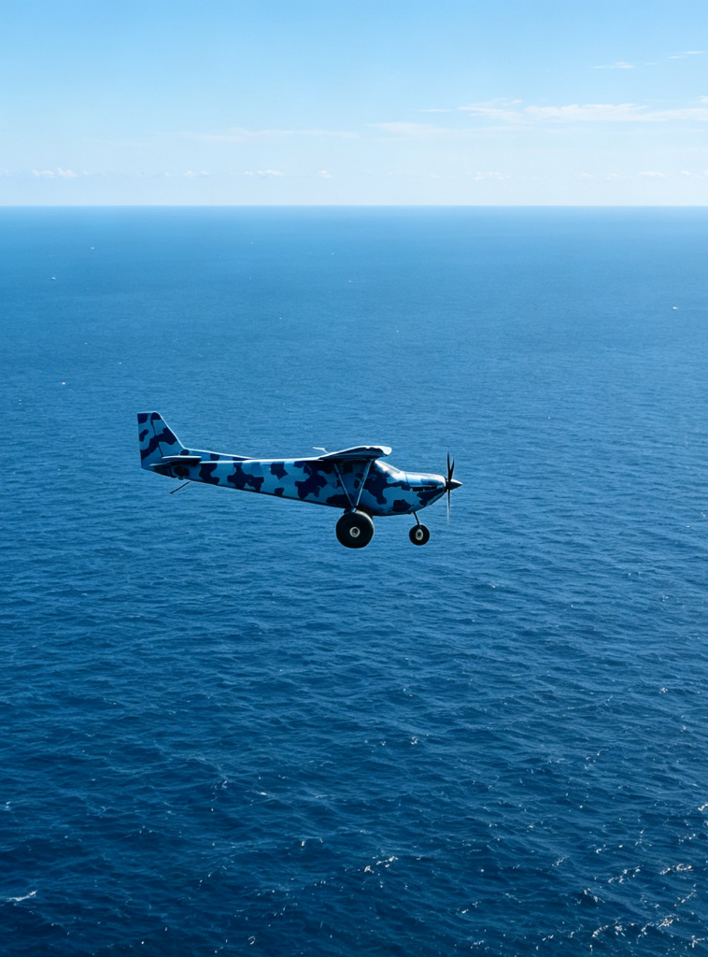
04
飞行性能 / Flight Performance
240
190
6600+
VNE km/h 最大空速
Cruise km/h 巡航速度
Ceiling m 最大高度
800
5
≤100
Range km 最大航程
Endurance h 最大航时
STOL m 起降距离
各阶段性能 / Phase Performance
Phase 阶段 | Parameter 参数 | Value 数值 | Unit 单位
Takeoff 起飞 | Climb Rate 爬升率(海平面) | 6 | m/s
Cruise 巡航 | Track Error 航迹跟踪误差 | 5-10 | m RMS
Landing 着陆 | Touchdown Speed 接地速度 | 70 | km/h
C2 测控 | Max C2 Range 最大测控距离 | 140 | km
Env 环境 | Operating Temp 工作温度 | -20~+50 | ℃
Speed 速度 | Stall (flap) 失速速度(放襟翼) | 56 | km/h
Notes:
Flight envelope: VNE 201km/h, cruise 160km/h, ceiling 2000m, range 700km, endurance 4.5h, STOL ≤100m. 飞行包线：最大空速201km/h，巡航160km/h，最大高度2000m，最大航程700km，最大航时4.5h，起降距离≤100m。

Slide 7
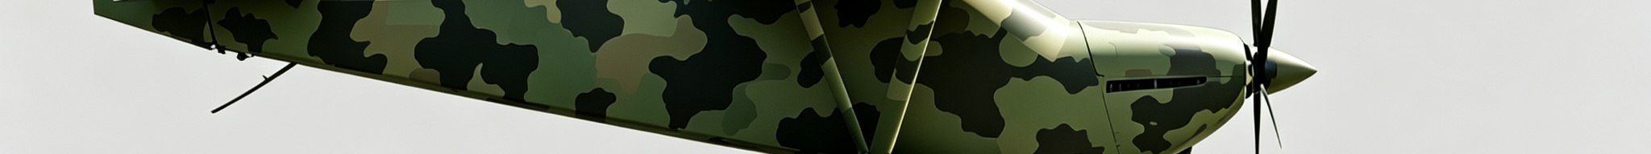
05
系统组成 / System Architecture
Air platform + GCS + C2 link. Air platform includes 5 subsystems. / 空中平台+地面站+通信链路，空中平台含五大子系统
FMC 飞行管理与飞行控制
C2 指挥控制
PES 动力能源
AFS 机体系统
Payload 任务载荷
• Triple Redundancy FCC 三冗余飞控
• Triple IMU 三冗余
• Dual Servo 双余度
• EKF Navigation
• 3-level Degradation
• 2.4G/5.8G RC
• 915MHz Telemetry
• AES-256 Encrypt
• Dual GCS 一机两控
• C2 Range 140km
• OP-200T Engine
• XF31C-69 Propeller
• 90L Fuel Tank
• Dual Power 双通道
• Backup Battery≥30min
• High-wing 上单翼
• Full-span Flaperon
• Cargo≥0.8m³
• Tricycle Gear 前三点
• Nav Lights 航行灯
• Modular Cargo
• 8-10 D-rings
• Cargo Net 网兜
• Temp Control
三大设计特点 / Three Key Design Features
Redundancy 冗余设计
Modularity 模块化设计
4-Layer Defense 四级纵深防御
Triple Redundancy FCC ，Triple IMU, dual servo, heterogeneous dual link, dual power. All critical systems backed up. /三冗余飞控、
三冗余IMU、双余度舵机、异构双链路、双通道电源
Modular subsystem interfaces for quick replacement; modular cargo bay for multi-mission payloads. / 子系统模块化接口，货舱模块化支持多任务载荷
Sensor→Actuator→Power→System degradation, full fault coverage. / 传感器级→执行机构级→动力失效级→系统级降级
System consists of Air Platform, Ground Control Station (GCS) and Communication Link. / 系统由空中平台、地面控制站和通信链路三大部分组成。
Air platform includes Flight Management (FMC), Command & Control (C2), Power & Energy (PES), Airframe System (AFS) and Payload. / 空中平台包含飞行管理与飞行控制、指挥控制、动力能源、机体系统和任务载荷五大子系统。
Notes:
System architecture includes 5 subsystems and 3 key design features. / 系统组成包含五大子系统和三大设计特点。

Slide 8
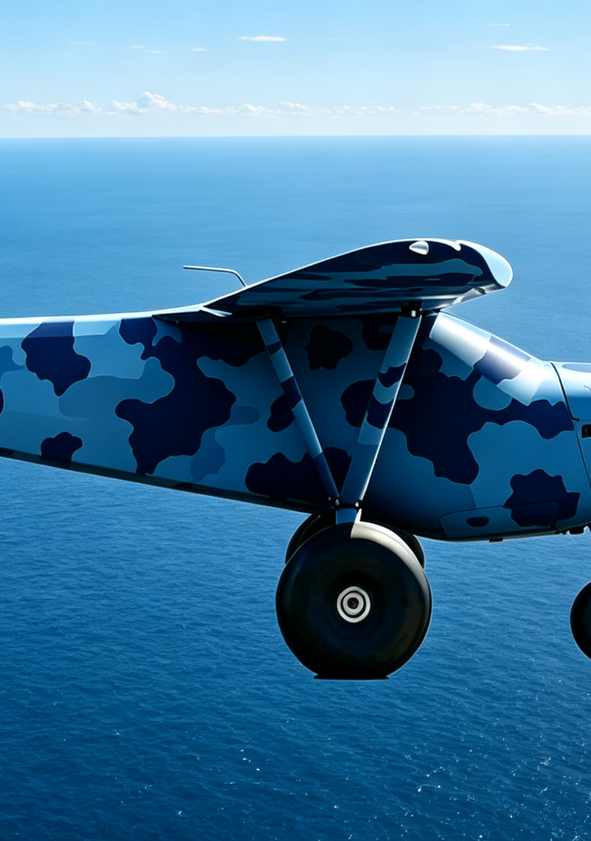
06
地面控制站 / Ground Control Station
Dual-seat GCS, dual GCS control, hardware redundancy for high reliability. / 双席位地面站，一机两控，硬件冗余设计
Seats 席位配置
Dual-seat (PIC/Monitor), remote deployable / 双席位（主控/监控），可异地部署
Compute 计算冗余
Dual hot-standby compute per station / 每站双机热备计算主机
Power 应急供电
LiFePO4 ≥800Wh, switch <5ms, ≥2h / 锂铁电池≥800Wh，切换<5ms，续航≥2h
Display 显控界面
Flight params, map, link status, Remote ID / 飞行参数、航迹地图、链路状态、Remote ID
一机两控 & 安全 / Dual GCS & Safety
Control Switch 控制权切换
E-Stop 应急停止按钮
Request-grant, physical key override / 请求-授权机制，物理钥匙强制接管
Red anti-misuse, one-key terminate / 红色防误触设计，一键终止飞行
Note: GCS should be deployed with line-of-sight for link quality. Link margin <6dB for >3s triggers emergency. / 注：地面站应在视距通视条件下部署，链路余量低于6dB超过3秒触发应急程序。
Notes:
GCS features dual-seat, dual hot-standby compute, 800Wh backup battery, and dual GCS control mechanism. / 地面站采用双席位设计，每站双机热备，800Wh应急电池，支持一机两控。

Slide 9
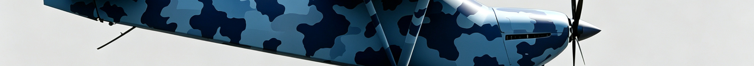
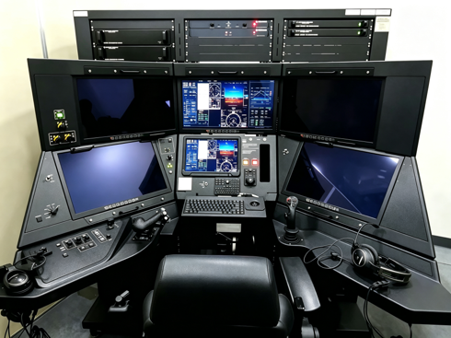
07
操作指南 / Operating Procedures
Standard flight: Pre-flight → Takeoff → Cruise → Mission → Return → Landing / 标准飞行流程：起飞前检查→起飞→巡航→任务执行→返航→着陆
Pre-flight 起飞前
Takeoff 起飞
Cruise 巡航
Mission 任务
Return 返航
Landing 着陆
Airframe check
Fuel≥30L
Link≥12dB
Battery≥80%
Full-span flaperon
Roll≤40m
Climb 6m/s
Rotate 70km/h
Cruise 160km/h
Alt≤6600+m
Track err 5-15m
Auto mode
Pre-set route
DAA active
Link monitor
Auto alert
Fuel≤10% alert
Fuel≤5% RTH
Auto route plan
Alternate reachable
Flap approach
Touchdown 70km/h
Roll≤40m
Brake lock
起飞前检查 / Pre-flight Checklist
应急操作 / Emergency Procedures
# | Item 检查项目 | Standard 标准
1 | Airframe 机体外观 | No damage 无损伤
2 | Fuel 燃油量 | ≥30L
3 | Propeller 螺旋桨 | No crack 无裂纹
4 | C2 Link 测控链路 | Margin≥12dB
5 | GCS Battery 地面站电池 | ≥80%
6 | Cargo 货物固定 | Net locked 锁定
Link Loss: Auto emergency, fly to pre-set alternate / 链路中断：自动应急，飞往预设备降点
Engine Out: Best glide, select landing spot / 发动机停车：最佳滑翔，选择迫降点
Total Power Loss: Backup battery≥30min, emergency / 全机断电：应急电池≥30min，执行应急
All emergency procedures are automated. Pilot may override via GCS. / 所有应急程序自动执行，飞手可通过地面站干预。
Report any incident within 24h. / 任何事故须24小时内上报。
Notes:
Standard 6-phase flight procedure with pre-flight checklist and 3 emergency procedures. / 标准六阶段飞行流程，含起飞前检查清单和三项应急操作程序。

Slide 10
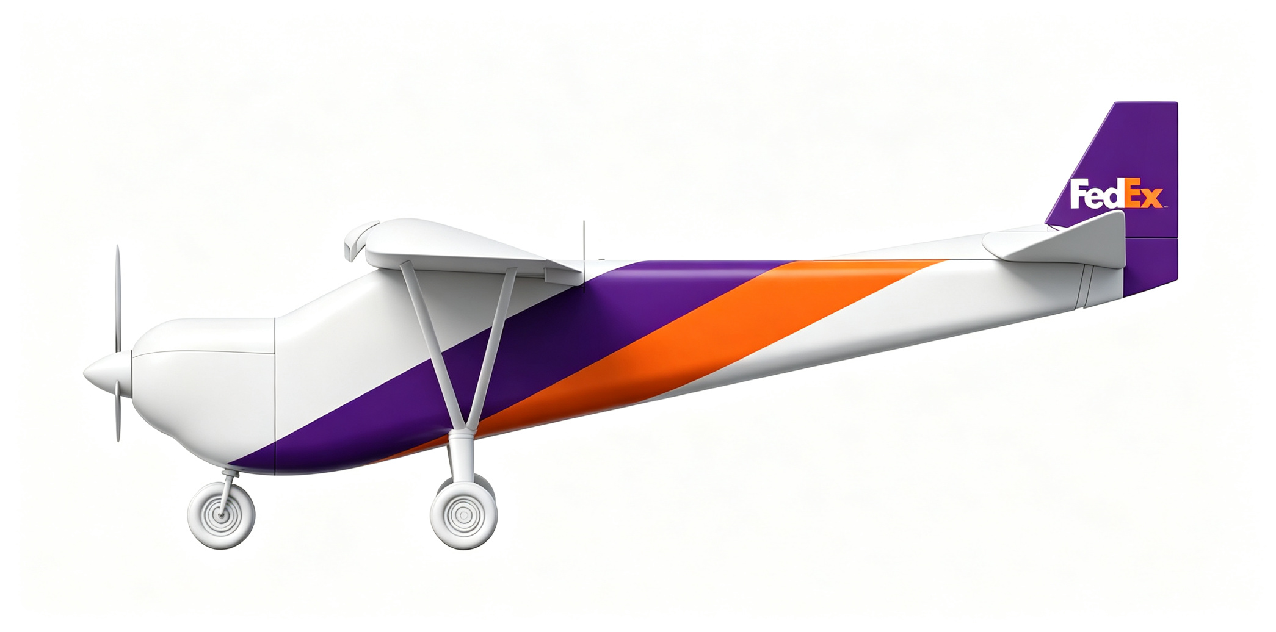
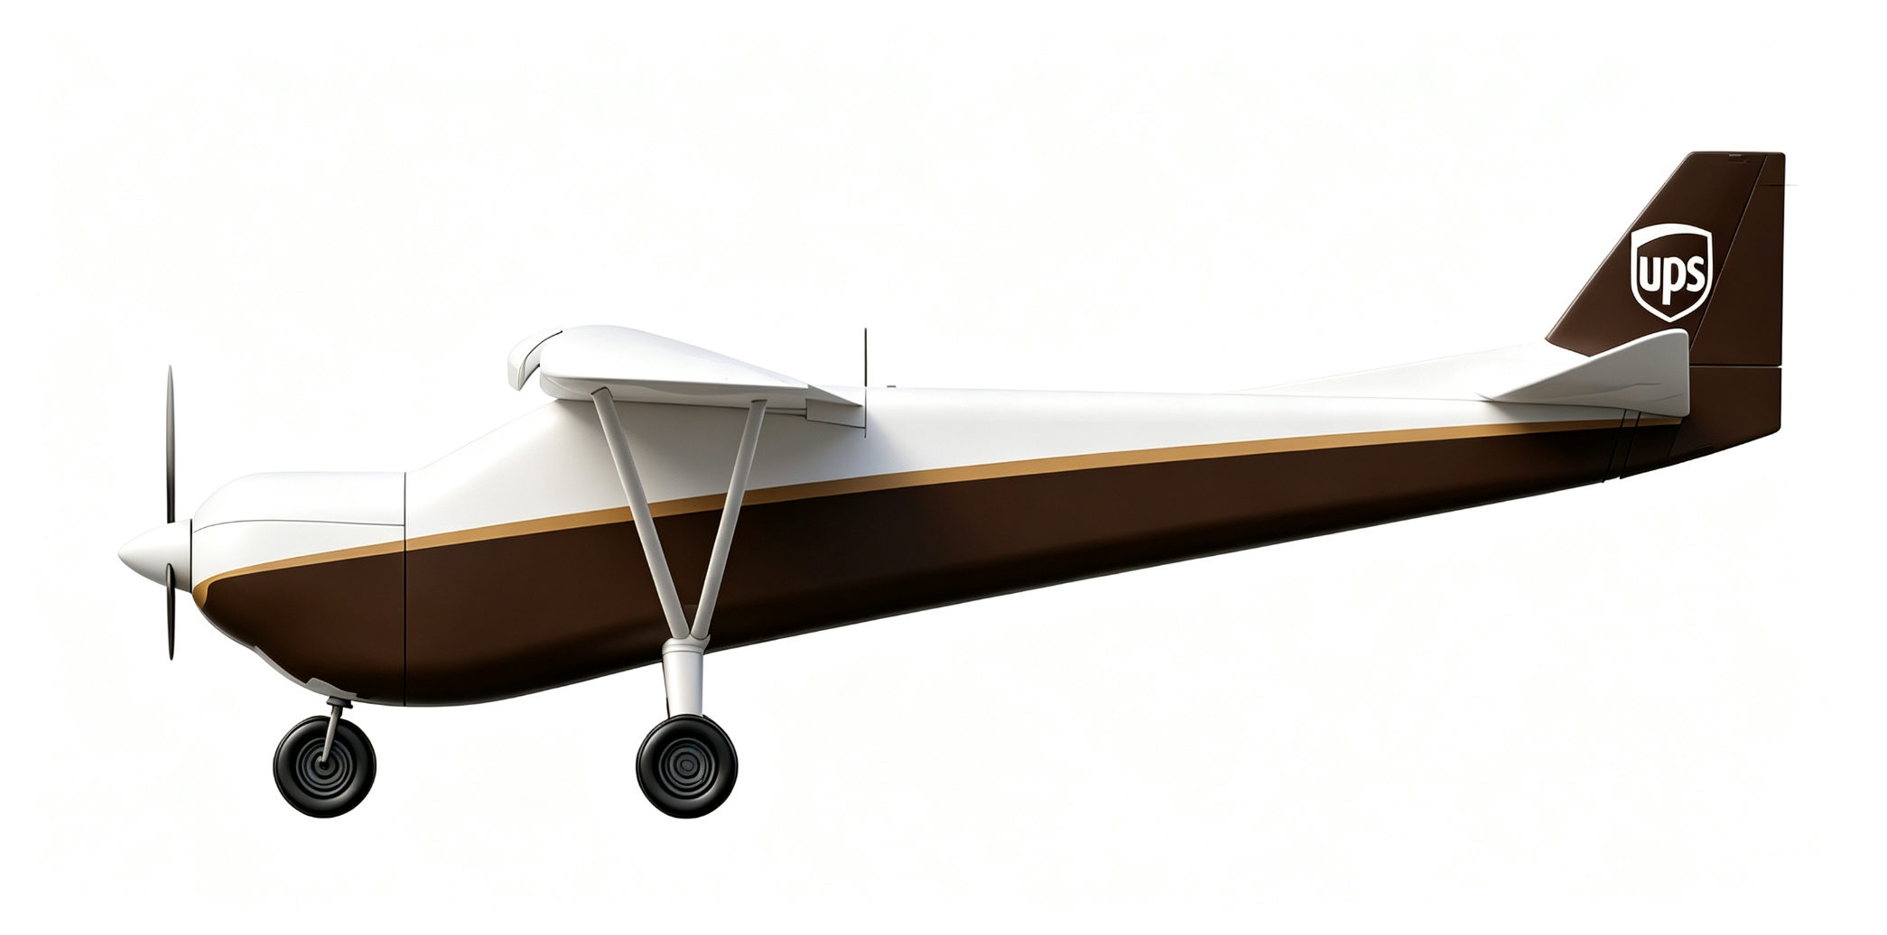

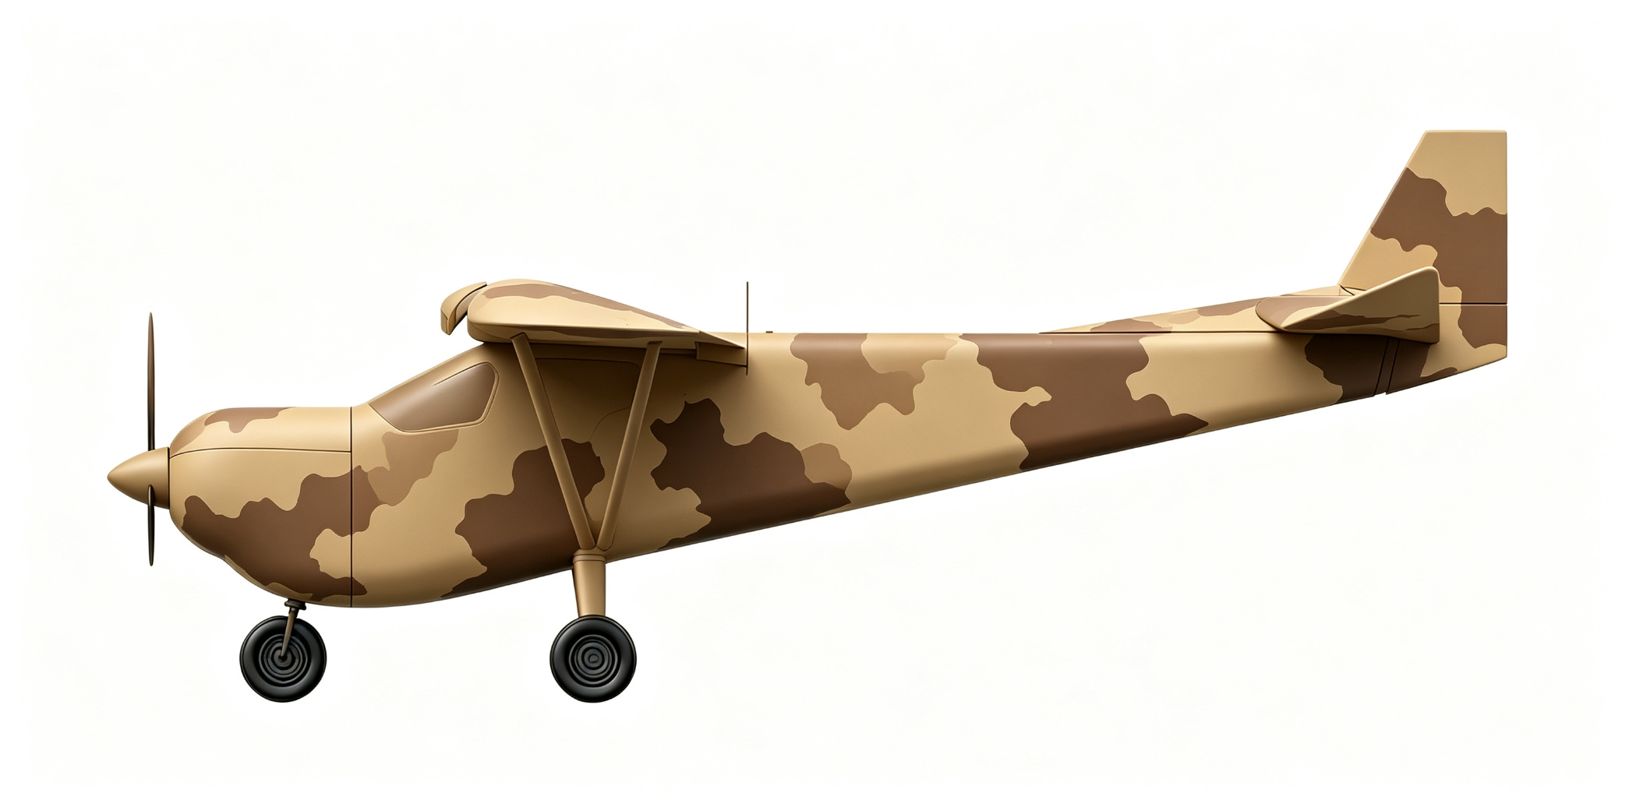
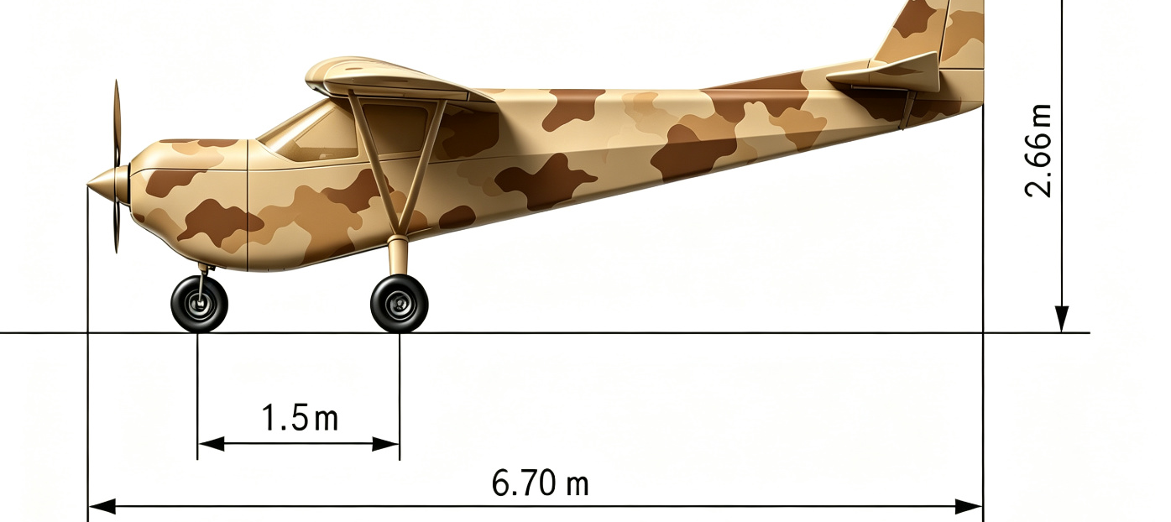
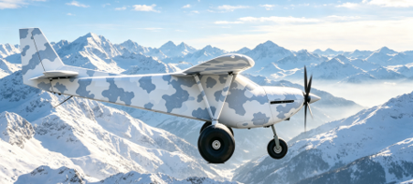
08
应用场景 / Application Scenarios
One platform, multiple liveries & environments — Cargo, Military, Jungle, Desert / 同一平台，多种涂装与环境方案
FEDEX Cargo — 350kg payload / 短途物流
UPS Cargo — modular bay / 区域配送
Jungle — patrol & rescue / 丛林巡检救援
Desert Camo — plateau & desert / 荒漠戈壁高原
Desert Camo — recon & border / 军事侦察边境
Jungle — tactical transport / 林区战术运输
AI-101 features modular design — same airframe supports cargo, military, jungle and desert missions via livery & payload swap. / AI-101采用模块化设计，同一飞行平台可通过更换涂装和任务载荷适配物流、军事、丛林、荒漠等多种场景。
STOL (≤100m) enables operation from jungle clearings, desert dirt strips and grass runways — true "Sky Jeep" all-terrain reach. / 超短距起降能力（≤100m）使其可在丛林空地、荒漠土路、草地跑道起降，真正实现"空中吉普"全地形到达。
Notes:
6 application scenarios: FEDEX, UPS, Jungle×2, Desert Camo×2. / 6款应用场景：FEDEX、UPS、丛林×2、沙漠迷彩×2。

Slide 11
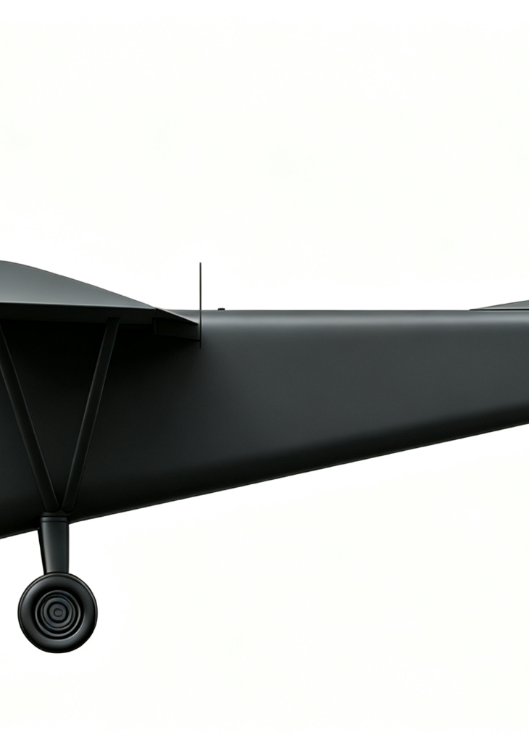
09
安全须知 / Safety Instructions
WARNING: Read manual before operation. Strict compliance required. / 警告：操作前必须仔细阅读本说明书，严格按规程操作
飞行安全 / Flight Safety
• Operate in segregated airspace only, comply with CCAR-92 / 仅在隔离空域飞行，遵守CCAR-92
• Verify C2 link margin ≥12dB before flight / 飞行前确认链路余量≥12dB
• No flight over crowds, airport zones, military areas / 严禁在人员聚集区、机场净空区、军事禁区飞行
• Link margin <6dB for >3s triggers emergency / 链路余量<6dB超3秒触发应急
• No flight in adverse weather (storm, high wind, low visibility) / 严禁在恶劣天气飞行
地面操作 / Ground Operations
• Keep clear of propeller arc when engine running / 发动机运转时严禁靠近螺旋桨
• No smoking during refueling, use 95# gasoline / 加油时严禁烟火，使用95号汽油
• Secure cargo with net & hooks, no overloading / 货物必须用网兜挂钩固定，严禁超载
• Keep E-Stop accessible at all times / 应急停止按钮必须保持可触及
维护安全 / Maintenance Safety
• Disconnect battery before maintenance, wait for propeller stop / 维护前断开电池，等待螺旋桨停止
• Use only OEM or certified parts / 仅使用原厂或经认证备件
• Engine maintenance in well-ventilated area / 发动机维护在通风良好区域进行
7×24 · Report incident within 24h / 技术支持7×24小时，事故24小时内上报
Notes:
Safety covers flight, ground, maintenance and emergency contact. / 安全须知涵盖飞行、地面、维护和应急联系。

Slide 12
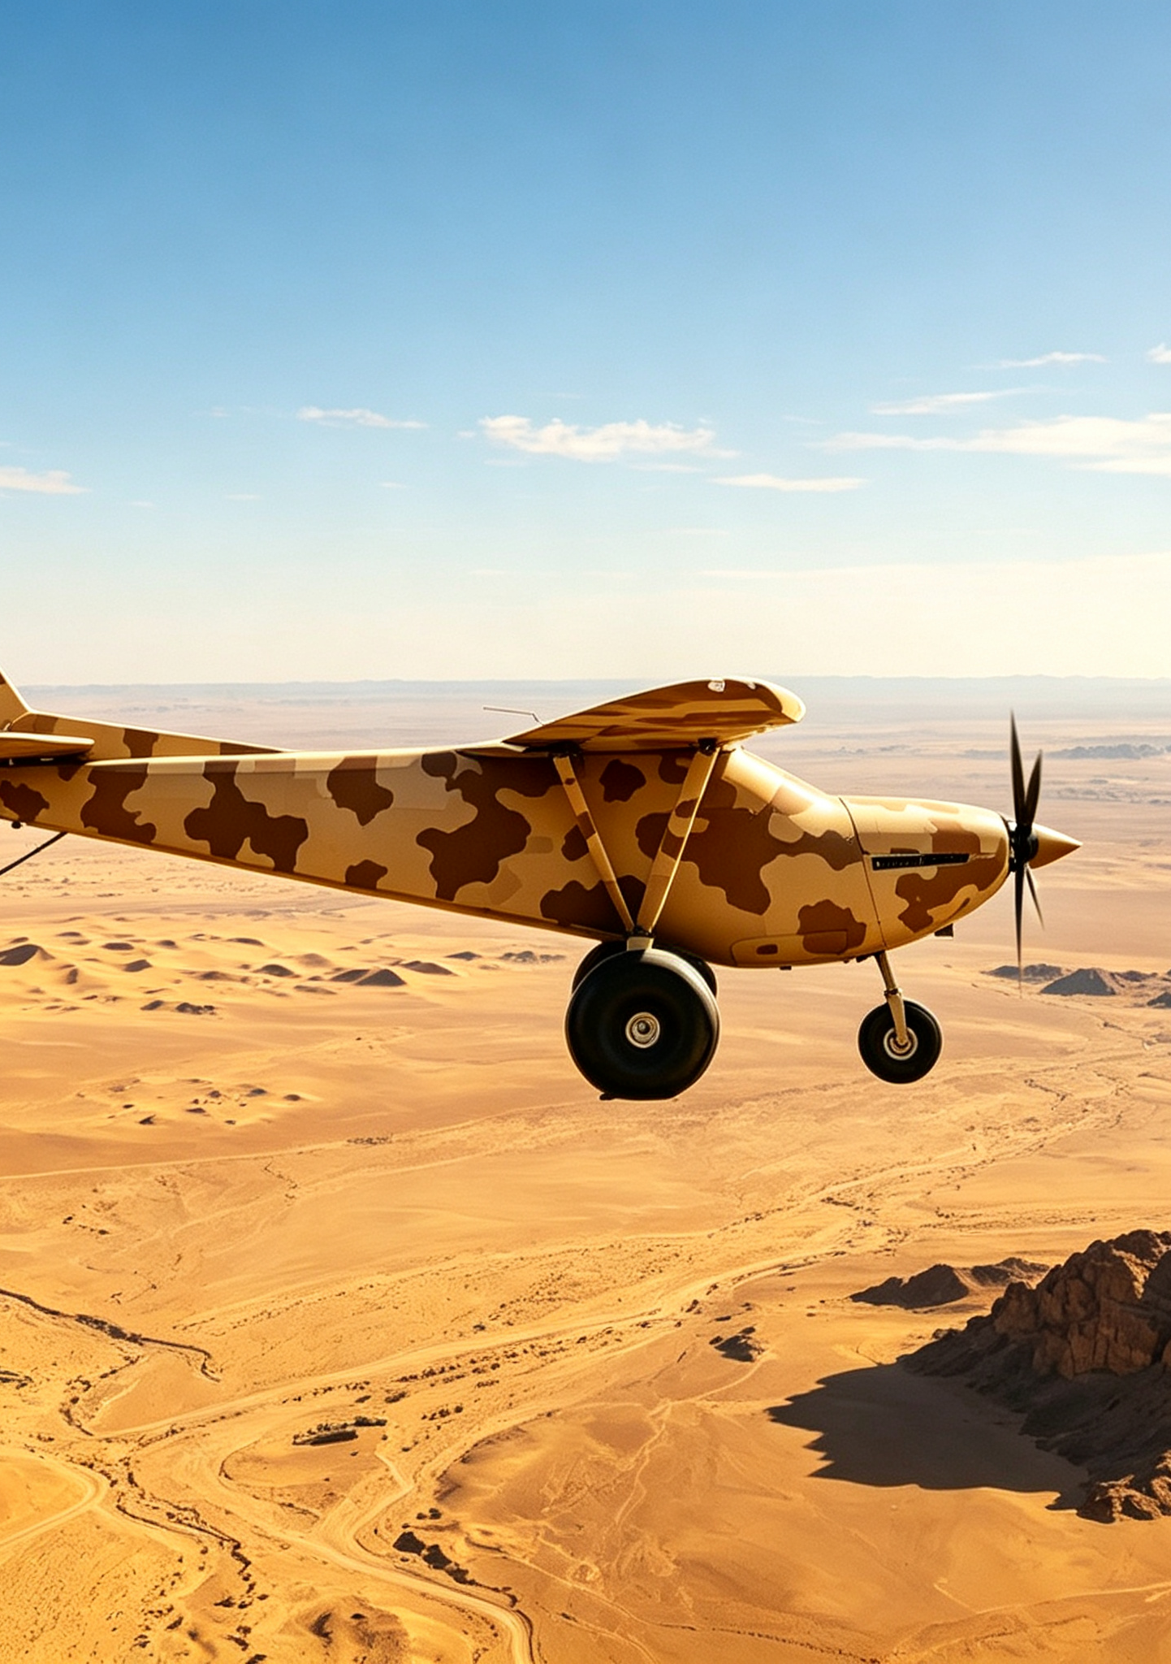
10
维护保养 / Maintenance
Regular maintenance ensures safety and extends service life. / 定期维护确保飞行安全，延长设备寿命
Level 级别 | Interval 周期 | Items 维护项目 | By 执行人
Pre-flight 飞行前 | Every flight 每次 | Airframe, fuel, prop, link, cargo / 外观、燃油、螺旋桨、链路、货物 | Pilot 飞手
Routine 日常 | Every 10h 每10小时 | Control surface, gear, battery, data export / 舵面、起落架、电池、数据导出 | Mechanic 维护员
Periodic 定期 | Every 50h 每50小时 | Oil, spark plug, fasteners, IMU calib / 机油、火花塞、紧固件、IMU校准 | Authorized 授权站
Annual 年度 | 200h/1yr 每200h/1年 | Engine overhaul, NDT, full inspection / 发动机大修、探伤、全面检测 | OEM 厂家
Special 特殊 | After incident 异常后 | Hard landing, crash, lightning, salt water / 重着陆、碰撞、雷击、盐水后 | OEM 厂家
存储要求 / Storage
运输要求 / Transport
• Temp -25~+55℃, Humidity ≤90% / 温度-25~+55℃，湿度≤80%
• Drain fuel for long-term storage / 长期存储放尽燃油
• Battery at 50%, recharge every 3 months / 电池充至50%，每3个月充电
• Dry, ventilated, no direct sunlight / 干燥通风，避免阳光直射
• Remove propeller, secure wings / 拆卸螺旋桨，固定机翼
• Drain fuel before transport / 运输前放尽燃油
• Use dedicated case with shock padding / 专用集装箱
• Secure firmly during road transport / 公路运输固定牢靠
End of Manual / 说明书完 — Thank you for choosing AI-101 Sky Jeep / 感谢您选择AI-101空中吉普
Notes:
5 maintenance levels: pre-flight, routine, periodic, annual, special. Plus storage and transport requirements. / 五级维护：飞行前、日常、定期、年度、特殊，含存储和运输要求。

