Slide 1
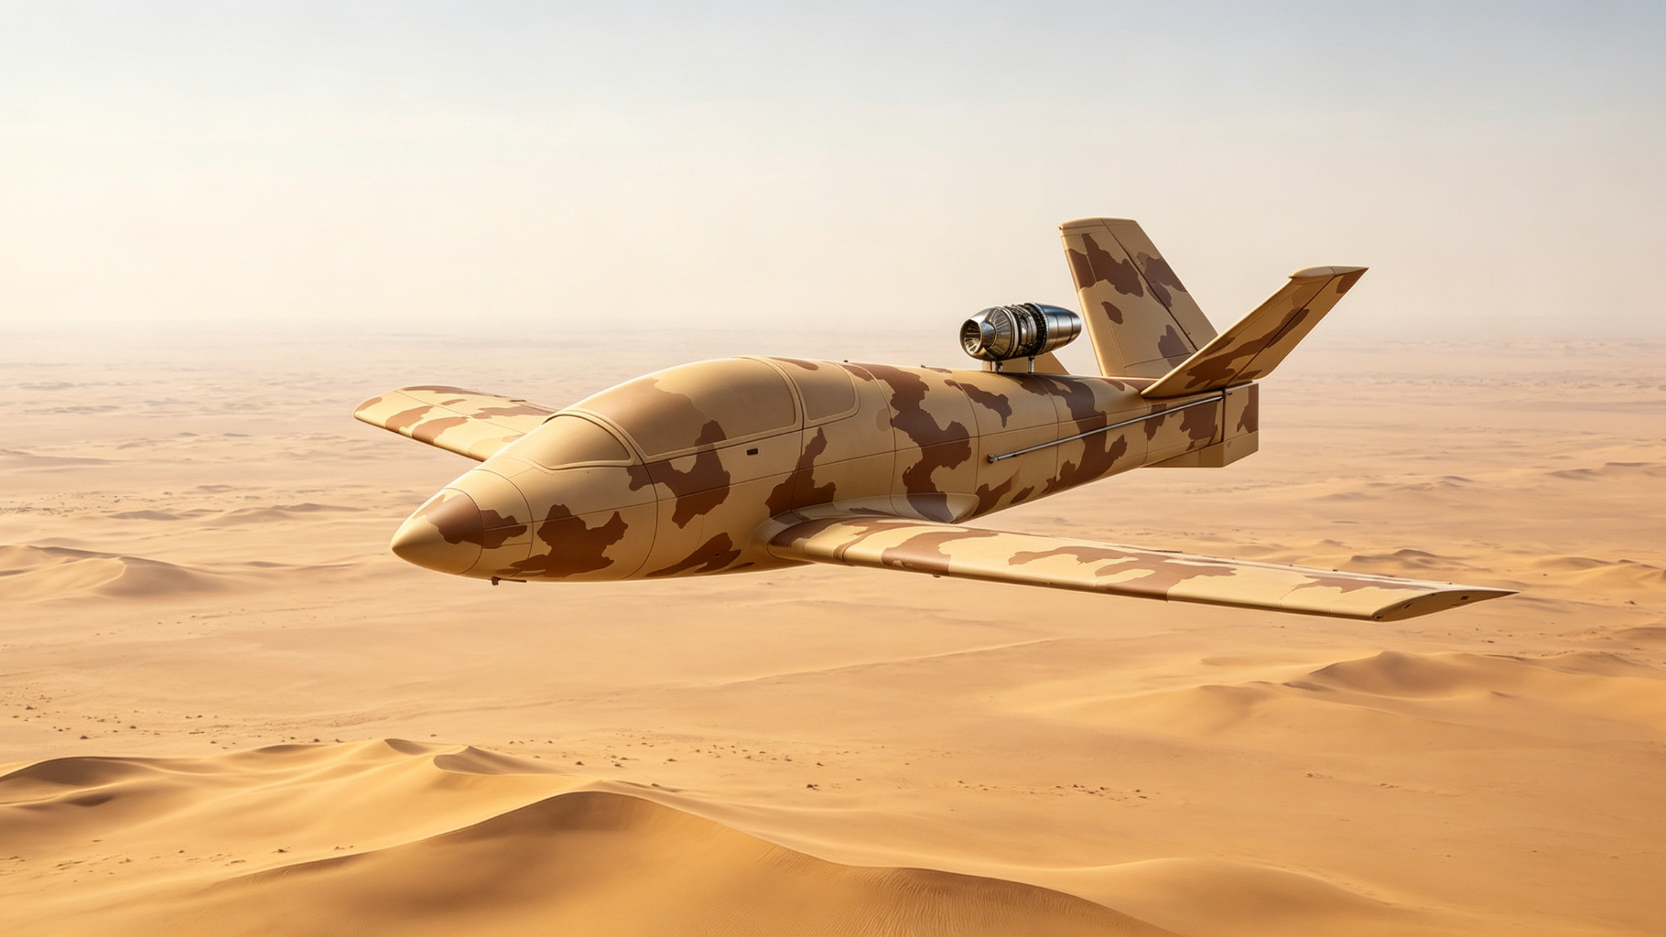
CONFIDENTIAL / PROPRIETARY
LOYAL WINGMAN
JET UAV
Conceptual Design Report
忠诚僚机喷气无人机
概念设计报告
Doc No. CL-2026-CD-001 | Rev. V1.0
Date: 2026-08-24 | Classification: Confidential
Notes:
This report presents the conceptual design of a loyal wingman jet UAV platform. The platform features a single dorsal-mounted jet engine, Y-tail configuration, and all-metal 6061-T6 aluminum structure. This presentation covers aerodynamic configuration, structural design, flight performance, propulsion, mission systems, and MUM-T operational concepts.
本报告呈现忠诚僚机喷气无人机平台的概念设计。平台采用单发背部喷气、Y型尾翼、6061-T6全金属铝合金结构。本演示涵盖气动布局、结构设计、飞行性能、动力系统、任务系统及有人-无人协同作战概念。

Slide 2
AGENDA
目录
01 Project Background 项目背景
02 Design Objectives 设计目标
03 Aerodynamic Configuration 气动布局
04 Geometric Parameters 几何参数
05 Structural Design 结构设计
06 Flight Performance 飞行性能
07 Propulsion System 动力系统
08 Mission Systems 任务系统
09 MUM-T Concept 协同作战概念
10 Technical Risks 技术风险
11 Conclusions & Recommendations 结论与建议
Loyal Wingman Jet UAV — Conceptual Design Report | CL-2026-CD-001 | Page 02
Notes:
This presentation covers 11 sections, from project background through conclusions. The bilingual format places English first, followed by Chinese, throughout all slides.
本演示共11个章节，从项目背景到结论建议。全篇采用英文在前、中文在后的双语格式。

Slide 3
01
Project Background
项目背景
MUM-T Transformation
Manned-Unmanned Teaming is the core direction of army aviation modernization. Loyal wingmen extend manned platform reach and survivability in high-threat environments.
Operational Need
A low-cost, expendable jet UAV capable of high-subsonic dash, forward reconnaissance, electronic warfare, decoy, and target designation missions alongside manned aircraft.
Jet vs. Propeller
Jet propulsion delivers superior dash speed and penetration capability, enabling rapid threat-zone transit and formation keeping with high-speed manned platforms.
有人-无人协同转型
有人-无人协同（MUM-T）是陆军航空兵现代化的核心方向。忠诚僚机可在高威胁环境中延伸有人平台的作战半径并提升生存力。
作战需求
低成本、可消耗喷气无人机，具备高亚音速冲刺能力，可与有人机协同执行前出侦察、电子战、诱饵诱骗及目标指示等任务。
喷气与螺旋桨对比
喷气动力提供更优的冲刺速度与突防能力，可快速穿越威胁区域并与高速有人平台保持编队。
Page 03 | CL-2026-CD-001
Notes:
The loyal wingman concept addresses the growing need for manned-unmanned teaming in modern battlefield. Jet propulsion is chosen over propeller for higher dash speed and penetration. This platform is designed as a low-cost, attritable asset.
忠诚僚机概念回应了现代战场中有人-无人协同日益增长的需求。选择喷气动力而非螺旋桨是为了更高的冲刺速度和突防能力。本平台定位为低成本、可消耗资产。

Slide 4
02
Design Objectives
设计目标
Parameter (EN) | 参数（中文） | Requirement | Category
Max Level Speed | 最大平飞速度 | >= 400 km/h | Performance
Stall Speed (Landing) | 失速速度（着陆构型） | <= 100 km/h | Takeoff/Landing
Mission Radius | 任务半径 | >= 150 km | Range
Payload Capacity | 有效载荷能力 | >= 80 kg | Mission
Max Takeoff Weight | 最大起飞重量 | <= 700 kg | Weight
Deployment Prep Time | 部署准备时间 | <= 30 min | Logistics
Transport Width (wings off) | 运输宽度（外翼拆卸） | <= 2.0 m | Transport
Page 04 | CL-2026-CD-001
Notes:
Eight top-level design requirements define the platform: speed, stall, range, payload, weight, deployment, and transport. These are derived from the Bangladesh Army operational requirements for a low-cost attritable jet loyal wingman.
八项顶层设计要求定义了平台：速度、失速、航程、载荷、重量、部署和运输。这些要求源自孟加拉陆军对低成本可消耗喷气忠诚僚机的作战需求。

Slide 5
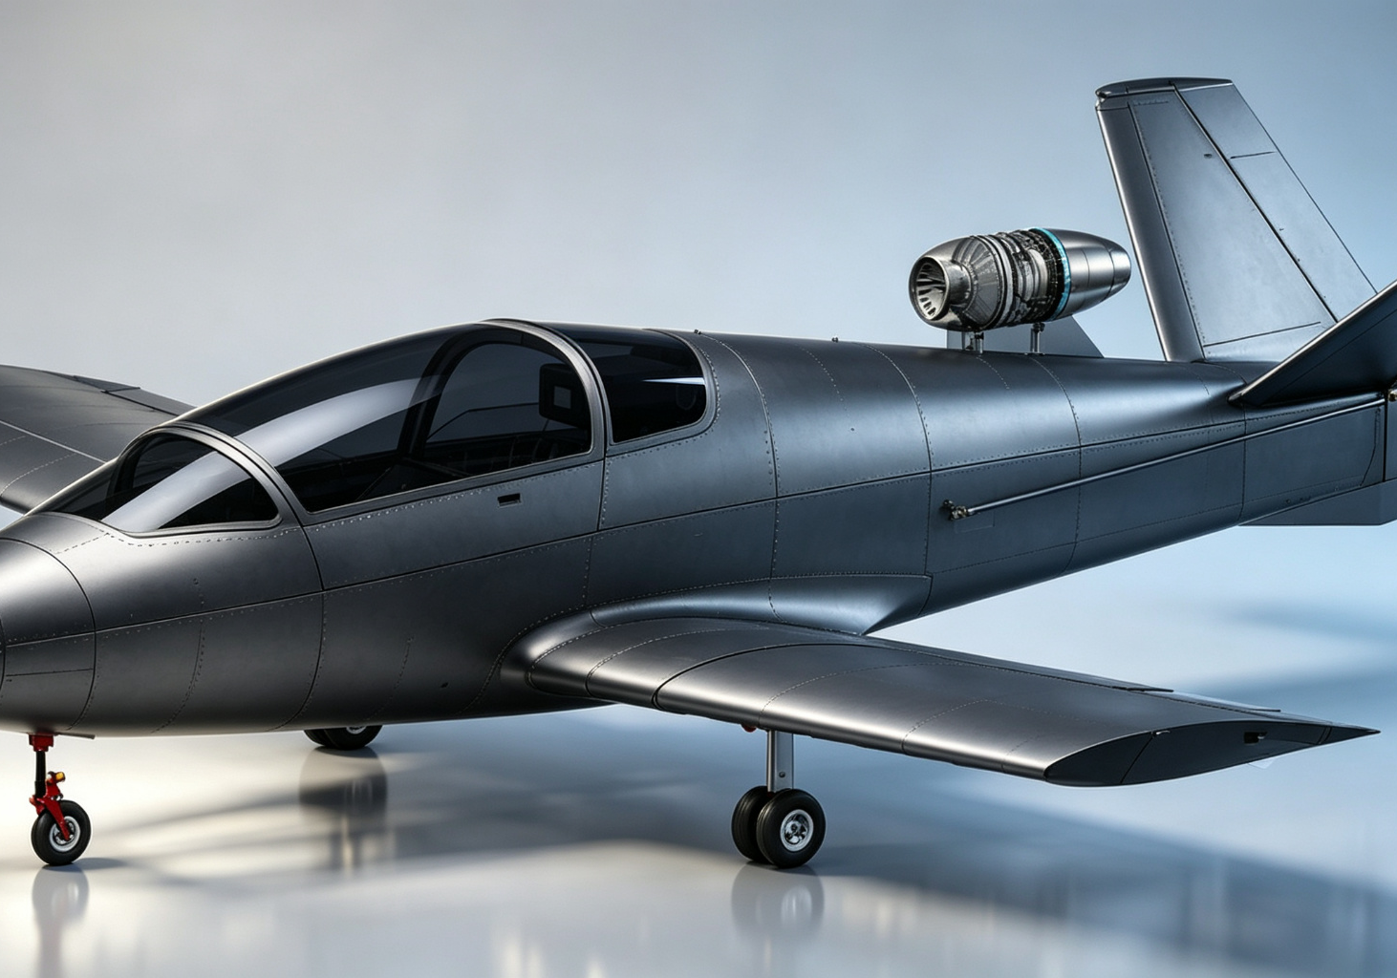
03
Aerodynamic Configuration
气动布局
Dorsal Jet Engine 背部喷气
Single jet engine dorsally mounted behind mission bay. Reduces FOD ingestion; frees underside for payloads.
单发喷气发动机背部安装于任务舱后方。降低异物吸入风险；释放机腹载荷空间。
Y-Tail Y型尾翼
Two canted surfaces combine yaw and pitch control. Reduces side RCS; avoids exhaust interference.
双倾斜尾翼面兼顾航向与俯仰控制。降低侧向RCS；避开喷流干扰区。
Low Wing 低单翼
Low-mounted wing with flaps. Simplifies gear attachment; ground effect cuts landing speed.
下单翼配襟翼。简化起落架连接；地面效应降低着陆速度。
Airfoil: NACA 64-415 翼型
Laminar flow airfoil, 15% thickness. Optimal cruise Cl 0.2-0.4; mild stall.
层流翼型，15%相对厚度。巡航Cl 0.2-0.4最优；失速特性温和。
Configuration: Single Dorsal Jet + Y-Tail + Low Wing
布局：单发背部喷气 + Y型尾翼 + 低单翼
Page 05 | CL-2026-CD-001
Notes:
The aerodynamic configuration combines three key choices: dorsal engine for FOD protection and payload space, Y-tail for combined control and reduced RCS, and low wing for simplified gear and ground effect. The NACA 64-415 airfoil provides laminar flow efficiency in cruise.
气动布局结合三个关键选择：背部发动机用于防异物和释放载荷空间，Y尾用于组合控制和降低RCS，低单翼用于简化起落架和利用地面效应。NACA 64-415翼型在巡航中提供层流效率。

Slide 6
04
Geometric Parameters
几何参数
Parameter (EN) | Imperial | Metric | 参数 / 说明
Length | 16' 6" | 5.03 m | 全长（含空速管）
Wing Span | 18' 0" | 5.49 m | 翼展（外翼安装）
Wing Area | 60.0 sq ft | 5.57 m² | 机翼面积（含机身遮挡）
Aspect Ratio | — | 5.41 | 展弦比 b²/S
Tail Height | 60.5" | 1.54 m | 尾翼高度（地面至顶端）
Tail Width | 74.25" | 1.89 m | 尾翼宽度（翼尖间距）
Width (wings off) | 76" | 1.93 m | 外翼拆卸后总宽（运输态）
Mission Bay Width | 24" | 0.61 m | 任务舱内部有效宽度
Page 06 | CL-2026-CD-001
Notes:
Key geometric parameters: length 5.03m, span 5.49m, wing area 5.57m², aspect ratio 5.41. The removable outer wings reduce transport width to 1.93m, fitting standard containers. 关键几何参数：长5.03m，翼展5.49m，翼面积5.57m²，展弦比5.41。可拆卸外翼将运输宽度降至1.93m，适配标准集装箱。

Slide 7
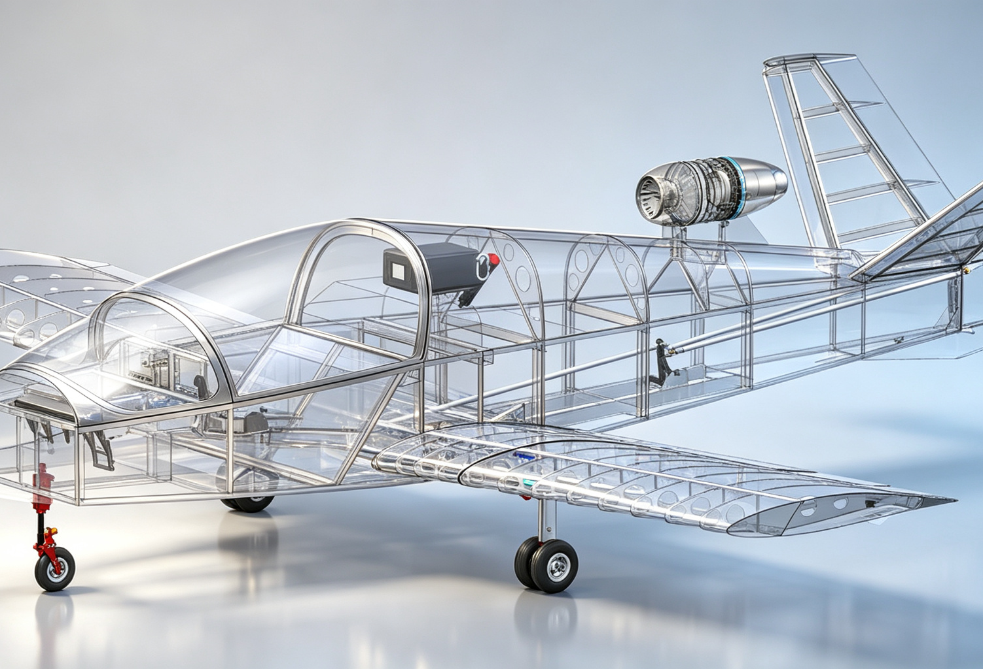
05
Structural Design
结构设计
Primary Material: 6061-T6 主体材料
Al-Mg-Si heat-treated alloy. Tensile 310 MPa, yield 276 MPa, density 2.70 g/cm³. Low cost, weldable, corrosion-resistant, ITAR-free.
铝镁硅系热处理合金。抗拉310MPa，屈服276MPa，密度2.70g/cm³。低成本、可焊、耐腐蚀、无出口管制。
Tubular Space Frame 管架式骨架
Aluminum tube truss fuselage + riveted skin. Semi-monocoque construction; field-repairable with basic tools.
铝合金管桁架机身+铆接蒙皮。半硬壳结构；前线可用基础工具修复。
Retractable Tri-Gear 可收放前三点
Air-oil shock struts, main gear retracts inward, nose gear aft. Vfe/Vle 201 km/h; emergency gravity extension.
油气缓冲支柱，主起落架向内收，前起落架向后收。最大收放速度201km/h；重力应急放下。
Modular Outer Wings 模块化外翼
Quick-disconnect joints with integrated fuel/electrical connectors. 2-person, 30-min rigging. Transport width 1.93 m.
快速连接接头集成燃油/电气接口。2人30分钟完成安装。运输宽度1.93m。
Transparent structure view — tubular space frame architecture 透明结构图 — 管架式骨架结构
Page 07 | CL-2026-CD-001
Notes:
The structure uses 6061-T6 aluminum tubular space frame for low cost and field repairability. Retractable tricycle gear reduces cruise drag. Modular outer wings enable standard container transport and rapid forward deployment. 结构采用6061-T6铝合金管架式骨架，低成本且可前线修复。可收放前三点起落架降低巡航阻力。模块化外翼支持标准集装箱运输和快速前线部署。

Slide 8
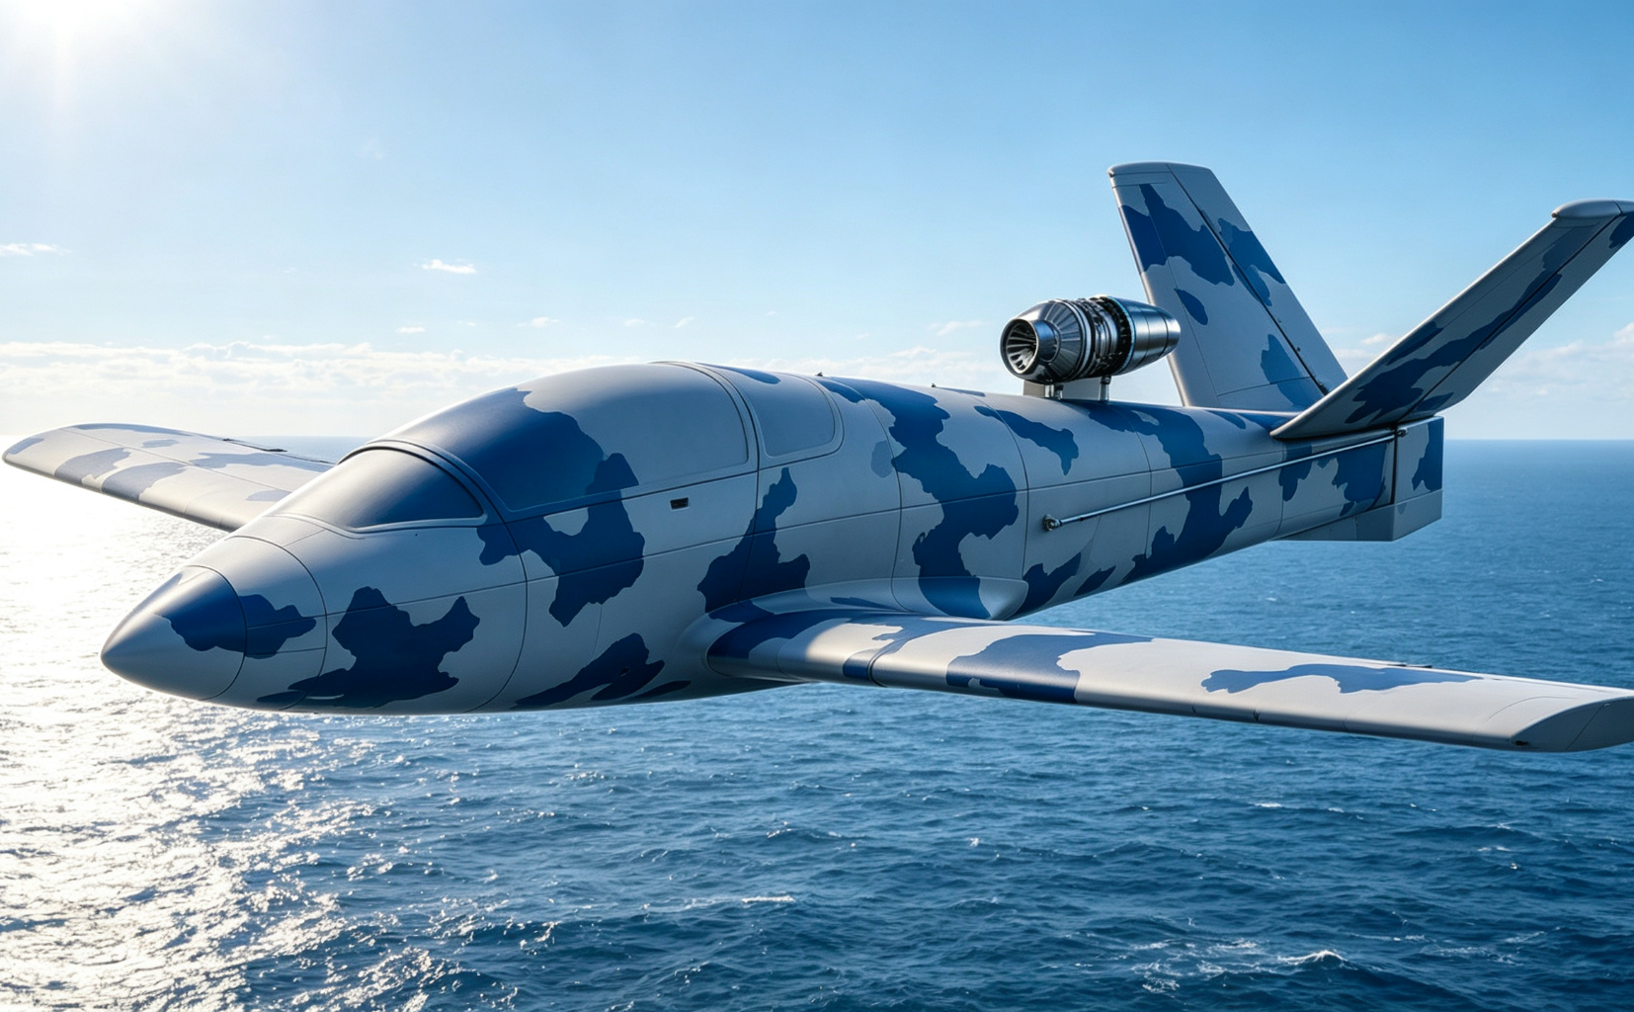
06
Flight Performance
飞行性能
Symbol | Definition 定义 | km/h
Vso | Stall (landing) 失速 | 93.3
Vs1 | Stall (clean) 干净构型 | 103
Vfe/Vle | Max flap/gear 襟翼/起落架 | 201
Va | Maneuvering 机动速度 | 252.6
Vne | Never Exceed 绝不超过 | 463
Takeoff/Landing 起降：
Ground roll ~250-350 m; takeoff to 15m ~400-500 m. Landing roll ~200-300 m. Required runway >= 600 m.
滑跑约250-350m；起飞至15m约400-500m。着陆滑跑约200-300m。所需跑道>=600m。
Maneuver 机动： Wing loading ~117 kg/m²; limit load +6g/-3g; climb rate ~8-12 m/s.
翼载荷约117kg/m²；极限载荷+6g/-3g；爬升率约8-12m/s。
Range Estimate 航程估算： 40 US Gal (151 L) fuel, ~121 kg. Turbofan option: 60-80 min cruise, ~300-400 km range, mission radius 100-150 km.
40美制加仑（151升）燃油，约121kg。涡扇方案：巡航60-80分钟，航程约300-400km，任务半径100-150km。
Page 08 | CL-2026-CD-001
Notes:
Flight envelope spans 93.3 km/h (Vso) to 463 km/h (Vne), a 4.96:1 speed ratio. The platform combines short-field capability (Vso 93 km/h) with high-subsonic dash (Vne 463 km/h). Estimated mission radius 100-150 km with turbofan propulsion. 飞行包线从93.3km/h（Vso）到463km/h（Vne），速度比4.96:1。平台兼顾短距起降（Vso 93km/h）与高亚音速冲刺（Vne 463km/h）。涡扇动力下任务半径约100-150km。

Slide 9
07
Propulsion System
动力系统
Single dorsal-mounted jet engine, thrust class 1.0-1.5 kN (100-150 kgf), T/W ratio ~0.15-0.22. Three candidate options evaluated below. 单发背部喷气发动机，推力级别1.0-1.5kN（100-150kgf），推重比约0.15-0.22。三种候选方案评估如下。
Parameter 参数 | Option A: Turbojet 涡喷 | Option B: Turbofan 涡扇 ★ | Option C: Indigenous 自研
Thrust 推力 | ~1.0 kN | ~1.2-1.5 kN | ~1.0 kN
SFC (cruise) 巡航耗油率 | 1.2-1.4 kg/(daN·h) | 0.9-1.1 kg/(daN·h) | ~1.4 kg/(daN·h)
Engine Weight 发动机重量 | 18-25 kg | 25-35 kg | 20-28 kg
Cost 成本 | Medium 中 | Higher 较高 | Low 低
Export Control 出口管制 | ITAR/EU 管制 | ITAR/EU 管制 | Controllable 可控
Recommendation 推荐度 | ★★★★ 备选 | ★★★★★ 首选 | ★★★ 长期
Recommendation 推荐： Option B (small turbofan) as primary for optimal thrust/SFC balance; Option A as low-cost backup; Option C as long-term TOT/indigenization path. 方案B（小型涡扇）为首选，推力与耗油率最优平衡；方案A为低成本备选；方案C为长期技术转让/本土化路径。
Page 09 | CL-2026-CD-001
Notes:
Three propulsion options evaluated: turbojet (cost-effective), turbofan (recommended, best efficiency), and indigenous (long-term TOT path). Dorsal S-bend intake provides total pressure recovery and EMI shielding. Convergent nozzle optimized for subsonic cruise. 评估三种动力方案：涡喷（高性价比）、涡扇（推荐，效率最优）、自研（长期TOT路径）。背部S弯进气道提供总压恢复和电磁屏蔽。收敛喷管优化亚音速巡航。

Slide 10
08
Mission Systems
任务系统
Modular mission bay (0.61 m width, >=80 kg payload) supports rapid role reconfiguration. Flight control auto-compensates CG for each module. 模块化任务舱（宽0.61m，载荷>=80kg）支持快速任务角色转换。飞控系统根据任务模块自动补偿重心。
Mission Role 任务类型 | Payload 任务载荷 | Weight 重量 | Function 功能说明
ISR 侦察监视 | EO/IR Turret 光电/红外吊舱 | 20-35 kg | Target detection, recognition, tracking 目标探测、识别、跟踪
EW 电子战 | Jamming Pod 电子干扰吊舱 | 25-40 kg | Radar & comm jamming, SEAD support 雷达/通信干扰，防空压制支援
Decoy 诱饵诱骗 | Radar Decoy / Enhancer 雷达诱饵 | 10-20 kg | Mimic manned aircraft RCS, lure air defense 模拟有人机RCS，诱骗防空系统
Targeting 目标指示 | Laser Target Designer 激光指示器 | 15-25 kg | Laser guidance for precision weapons 为精确制导武器提供激光照射
Comms Relay 通信中继 | Relay Node 通信中继节点 | 15-25 kg | Extend battlefield communication range 延伸战场通信距离
PSYOPS 心理战 | Broadcast / Leaflet Dispenser 广播/撒布器 | 20-30 kg | Battlefield psychological operations 战场心理宣传与传单撒布
Module swap target: <=15 min at forward operating base. 模块更换目标：前线基地<=15分钟。
Page 10 | CL-2026-CD-001
Notes:
Six mission roles supported via modular payload bay: ISR, EW, decoy, targeting, comms relay, and PSYOPS. Each module is hot-swappable in under 15 minutes. The flight control system automatically adjusts CG compensation based on installed module type. 六种任务角色通过模块化任务舱支持：侦察监视、电子战、诱饵诱骗、目标指示、通信中继和心理战。每个模块可在15分钟内热插拔更换。飞控系统根据安装模块类型自动调整重心补偿。

Slide 11
09
MUM-T Operational Concept
有人-无人协同作战概念
Mission Profile 任务剖面
Teaming Platforms 协同平台
# | Phase 阶段 | Time 时间 | Fuel 燃油
1 | Takeoff & Climb 起飞爬升 | 5-8 min | ~90%
2 | Enroute Cruise 出航巡航 | 20-30 min | ~60%
3 | Formation Join 编队会合 | 5-10 min | ~50%
4 | Mission Execute 任务执行 | 10-20 min | ~30%
5 | Return Cruise 返航巡航 | 20-30 min | ~15%
6 | Approach & Land 进近着陆 | 5-8 min | ~8%
Σ | Total Mission 总任务 | 80-120 min | reserve
Attack Helicopters 武装直升机
Forward reconnaissance, radar warning, decoy protection for Mi-24/35, AH-64 class platforms. 为Mi-24/35、AH-64级平台提供前出侦察、雷达预警、诱饵保护。
Light Attack Aircraft 轻型攻击机
Formation teaming for SEAD and target designation with Super Tucano / A-29 class. 与Super Tucano/A-29级编队协同，执行防空压制和目标指示。
Transport / Special Mission 运输/特种机
Escort jamming and threat screening for transport and ISR aircraft. 为运输机和情报监视侦察机提供伴随干扰和威胁筛查。
Wingman Swarm 僚机蜂群
2-4 wingmen formation for coordinated recon, saturation jamming, multi-axis decoy. 2-4架僚机编队，执行协同侦察、饱和干扰、多方向诱饵。
Control Mode: Authorized Control 控制模式：授权控制
Pilot issues mission commands via data link; wingman autonomously plans and executes. 飞行员通过数据链下达任务指令；僚机自主规划执行。
Page 11 | CL-2026-CD-001
Notes:
The MUM-T concept uses authorized control: pilots issue mission-level commands, wingmen execute autonomously. Total mission duration 80-120 minutes with 100-150 km radius. The platform can team with helicopters, light attack aircraft, transports, or operate in 2-4 ship swarms. MUM-T概念采用授权控制模式：飞行员下达任务级指令，僚机自主执行。总任务时长80-120分钟，半径100-150km。平台可与直升机、轻型攻击机、运输机协同，或以2-4架蜂群作战。

Slide 12
10
Technical Risks & Mitigation
技术风险与应对
ID | Risk 风险描述 | Level 等级 | Impact 影响 | Mitigation 应对措施
R-01 | Engine ITAR embargo 发动机出口管制 | High 高 | Propulsion unavailable 动力系统无法获取 | Indigenous 1kN turbojet; non-US suppliers (PBS CZ); strategic stockpile 自研1kN级涡喷；非美系供应商；战略储备
R-02 | Dorsal intake pressure loss 背部进气道总压损失 | Med 中 | Thrust loss, range reduction 推力损失、航程缩短 | CFD optimization; wind tunnel validation; design margin CFD优化；风洞验证；设计余量
R-03 | Y-tail stability coupling Y尾操稳耦合 | Med 中 | FCS complexity, flight test risk 飞控复杂、试飞风险 | 6-DOF simulation; wind tunnel tests; HIL simulation 六自由度仿真；风洞试验；半实物仿真
R-04 | 6061-T6 fatigue life 铝合金疲劳寿命 | Med 中 | Airframe service life limit 机体寿命受限 | 7075-T6/stainless reinforcement at critical joints; life management 关键接头7075/不锈钢补强；寿命管理
R-05 | Retractable gear reliability 可收放起落架可靠性 | Med 中 | Takeoff/landing accident risk 起降事故风险 | Mature supplier; emergency gravity extension; ground tests 成熟供应商；重力应急放下；地面试验
R-06 | Data link jamming 数据链抗干扰 | Med 中 | Team operation loss 协同作战失效 | FHSS + DSSS anti-jam; SATCOM backup; autonomous return 跳频+扩频抗干扰；卫星通信备份；自主返航
Overall assessment: Core risks concentrated in jet engine acquisition and aerodynamic optimization; manageable via phased validation (CFD -> wind tunnel -> subscale flight -> full-scale). 总体评估：核心风险集中在喷气发动机获取和气动优化；通过分阶段验证（CFD->风洞->缩比试飞->全尺寸）可控。
Page 12 | CL-2026-CD-001
Notes:
Six technical risks identified: engine ITAR (high), dorsal intake loss, Y-tail coupling, aluminum fatigue, gear reliability, and data link jamming (all medium). All are manageable through phased validation and mature subsystem selection. The platform uses proven 6061-T6 structure and light sport aircraft design standards, reducing overall technical risk. 识别六项技术风险：发动机出口管制（高）、背部进气道损失、Y尾耦合、铝合金疲劳、起落架可靠性、数据链干扰（均为中）。均可通过分阶段验证和成熟子系统选型控制。平台采用成熟6061-T6结构和轻型运动航空器设计标准，整体技术风险可控。

Slide 13
11
Conclusions & Recommendations
结论与建议
Key Conclusions 核心结论
Next Steps 下一步建议
01 Dorsal jet + Y-tail + low wing configuration is aerodynamically sound for high-subsonic UAV. 单发背部喷气+Y尾+低单翼布局适配高亚音速无人机。
02 6061-T6 tubular frame offers low cost, field repairability, and TOT compatibility. 6061-T6管架结构低成本、可前线修复、适配技术转让。
03 Wide flight envelope (93-463 km/h) balances short-field and dash capability. 宽飞行包线（93-463km/h）兼顾短距起降与冲刺。
04 Modular outer wings enable standard container transport (1.93 m width). 模块化外翼支持标准集装箱运输（1.93m宽）。
05 Six mission roles via modular payload bay; <=15 min hot-swap. 六种任务角色通过模块化任务舱实现；<=15分钟热插拔。
06 Mission radius 100-150 km meets army low-altitude teaming requirements. 任务半径100-150km满足陆军低空协同需求。
01 Finalize engine selection and intake-engine matching CFD. 确定发动机选型并开展进气道-发动机匹配CFD。
02 Full-aircraft CFD simulation; Y-tail stability assessment. 全机CFD仿真；Y尾操稳特性评估。
03 Build 1:2 or 1:3 subscale demonstrator for R/C flight test. 制造1:2或1:3缩比验证机开展遥控试飞。
04 Detailed weight estimation and CG analysis (MTOW <=700 kg). 详细重量估算与重心分析（MTOW<=700kg）。
05 Define mission bay mechanical and electrical interface standards. 定义任务舱机械与电气接口标准。
06 Define airworthiness path (ASTM F2339 or military standard). 明确适航路径（ASTM F2339或军用标准）。
07 Develop TOT technical package and personnel training plan. 制定技术转让（TOT）技术包与人员培训计划。
Recommendation: Proceed to Phase B Preliminary Design. 建议：进入B阶段初步设计。
Page 13 | CL-2026-CD-001 | Confidential / Proprietary
Notes:
Six key conclusions confirm the concept is technically feasible, mission-adaptable, and cost-effective. Seven recommended next steps define the path to Phase B preliminary design. The overall recommendation is to proceed with detailed design, prioritizing engine selection, CFD validation, and subscale flight demonstration. 六项核心结论确认本概念技术可行、任务适配、成本可控。七项下一步建议定义了进入B阶段初步设计的路径。总体建议是推进详细设计，优先开展发动机选型、CFD验证和缩比飞行演示。

